Slide 1




TWG Update
Nov 22, 2021
Project Milestones and Traffic Lights
Duncan Bees, Director Technical Programs duncan@openhwgroup.org
www.openhwgroup.org

Slide 2
Project Milestones
Project Concept
Basic concept behind the project agreed
Why are we doing the project
Project Launch
Initial list of features
What does the project comprise
Initial resource/project plan
Plan Approved
Requirements Specification Agreed
Full project plan available (how are we doing the project)
Project Freeze checklists identified
Project Freeze
Project is complete
All checklists passed

Slide 3
Planning and Tracking the milestones
Project level
Set out a plan
At each gate project forward to the future gates
Track the plan
Keep project team up to date on project status
Keep TWG up to date
TWG
Approve the plans
Communicate progress across all OpenHW projects
Assess current status of projects

Slide 4
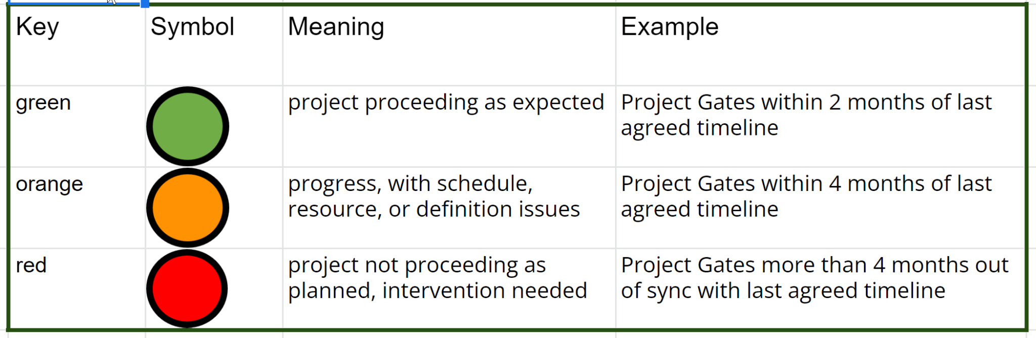
Traffic Lights

Slide 5
Updating Milestone Charts
Duncan work with each project to ensure
Current situation is accurately reflected
Project future gate milestones where they don’t currently exist
Long term
Milestones can be updated via pull request
Milestone charts updated and published to GIthub and the openhwgroup.org project page will point there

Slide 6
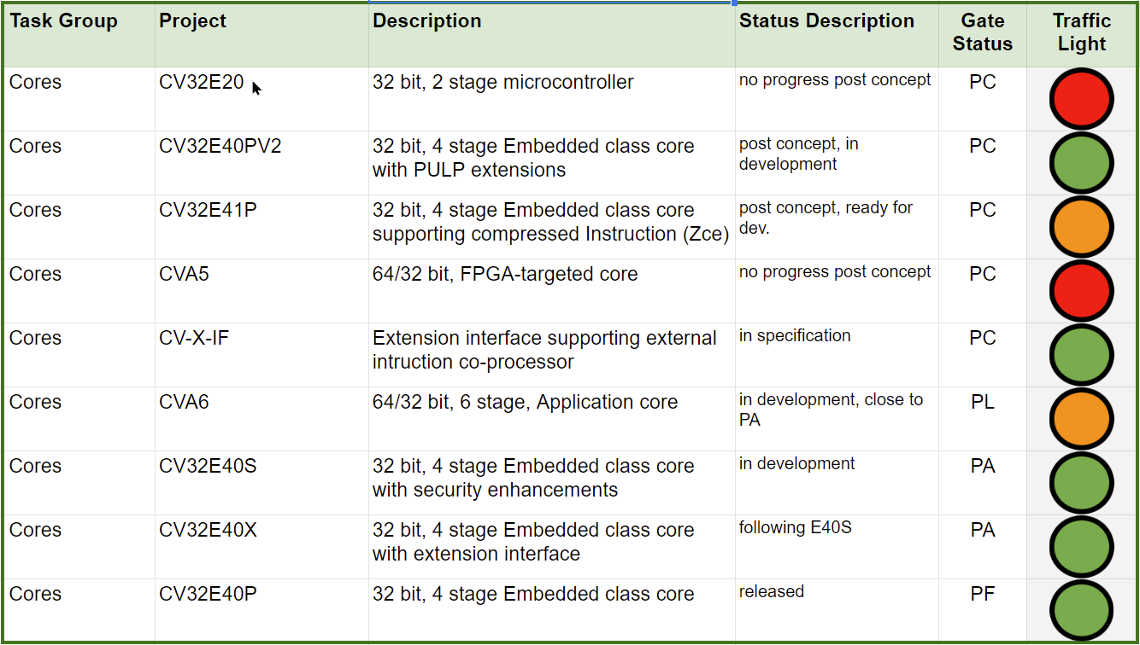
Cores

Slide 7
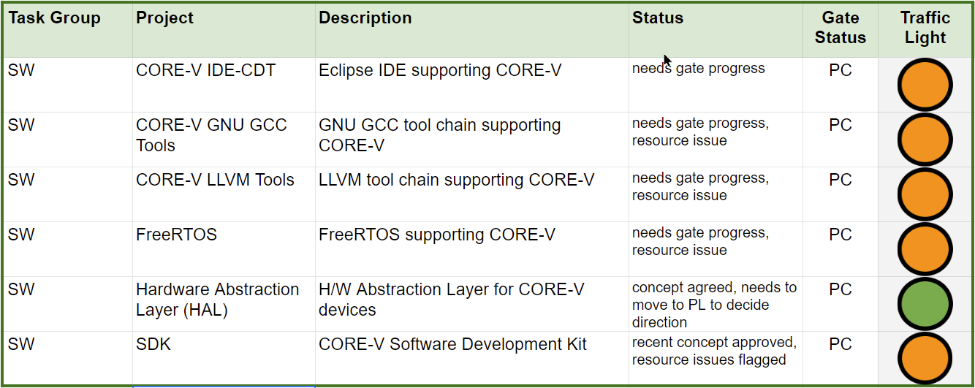
SW

Slide 8
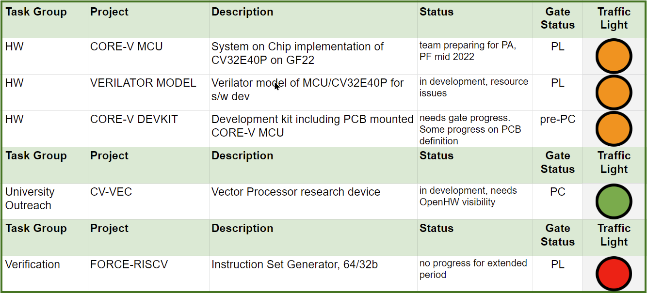
HW, UOTG, and Verification

Slide 9
Source data
Google spreadsheet

